Slide 1
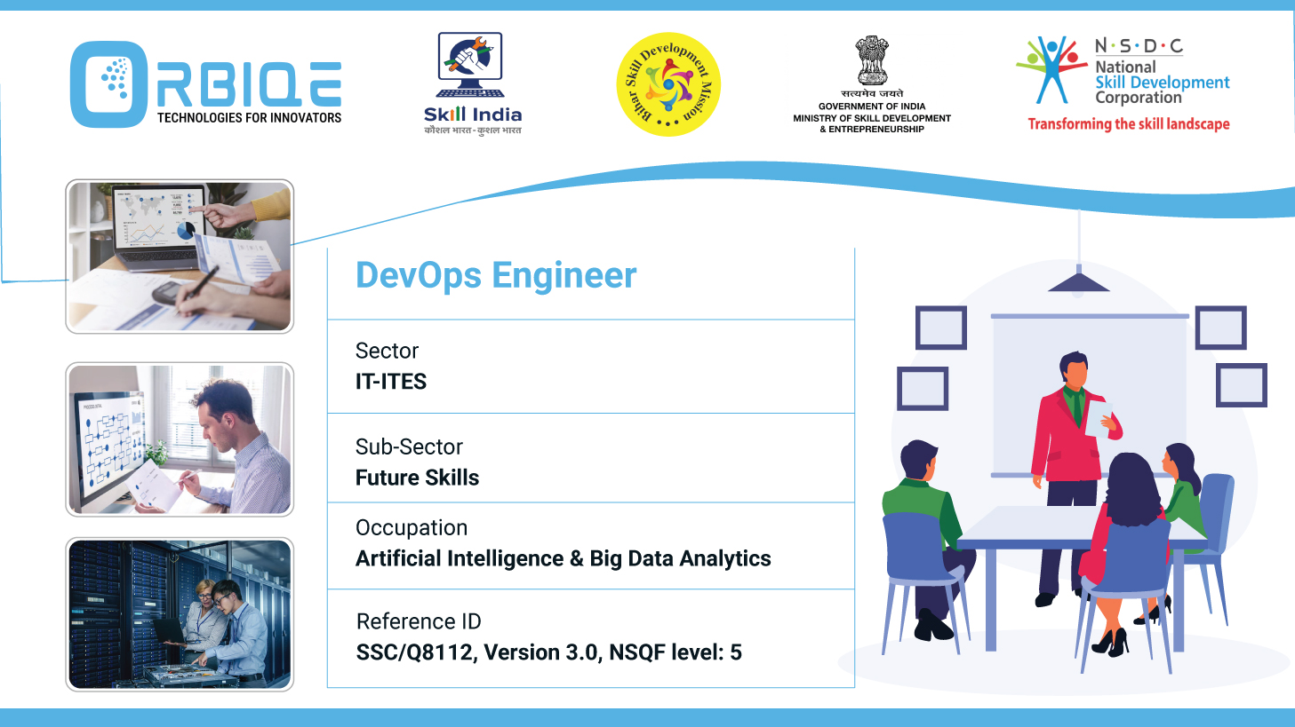
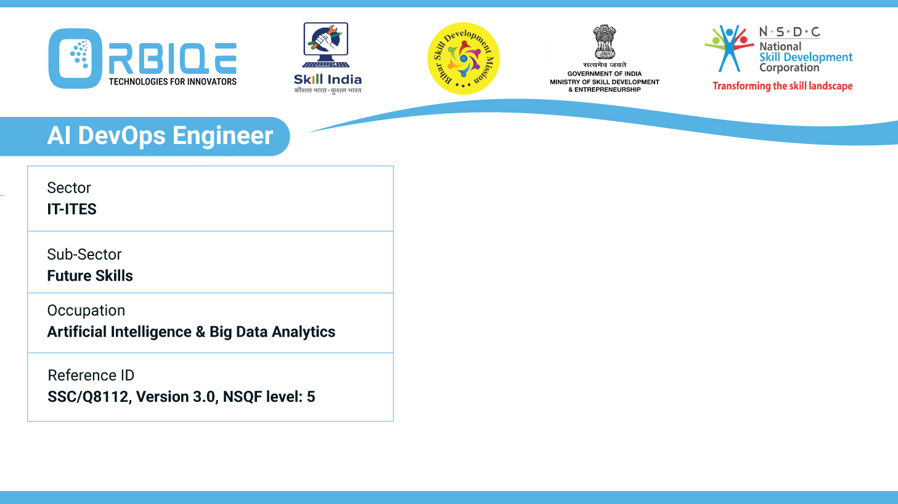
Name- Krishna Kant Dubey

Slide 2

Migration Stratégies: Techniques for Database Transfer

Slide 3
Agenda
Identify various techniques to migrate existing databases to new environments, ensuring a smooth transition with minimal disruption

Slide 4
Migration Planning Essentials
Assessment: Evaluate source and target environments,
compatibility, and performance requirements.
Backup: Always create a full backup before migration.
Testing: Use staging environments to simulate migration and
validate outcomes.
Rollback Strategy: Prepare contingency plans in case of failure.

Slide 5
Migration Techniques
Lift-and-Shift (Rehosting)
Dump and Restore
Replication-Based Migration
ETL (Extract, Transform, Load)
Hybrid Migration

Slide 6
Lift-and-Shift (Rehosting)
Use Case: Moving databases to cloud or new servers without redesign
Tools: AWS Database Migration Service (DMS), Azure Database
Migration Service.
Pros: Fast, minimal changes.
Cons: Doesn’t optimize for new environment.

Slide 7
Dump and Restore
Use Case: Migrating smaller databases or switching DBMS types.
Tools: mysqldump, pg_dump, mongoexport
Steps:
Export schema and data.
Transfer dump files.
Import into target DB.
Pros: Simple and reliable.
Cons: Downtime required; not ideal for large datasets.

Slide 8
Replication-Based Migration
Use Case: Zero-downtime migrations.
Tools: Logical replication (PostgreSQL), Change Data Capture (CDC
Steps:
Set up replication from source to target.
Sync changes in real-time.
Cut over once target is up-to-date.
Pros: Minimal disruption.
Cons: Complex setup; requires monitoring.

Slide 9
ETL (Extract, Transform, Load)
Use Case: When data transformation is needed during migration.
Tools: Apache NiFi, Talend, Informatica, AWS Glue.
Steps:
Extract data from source.
Transform schema/data types.
Load into target DB.
Pros: Flexible and customizable.
Cons: Slower; requires detailed mapping

Slide 10
Hybrid Migration
Use Case: Large-scale or phased migrations.
Approach:
Migrate non-critical tables first.
Gradually move workloads.
Use replication for critical data.
Pros: Controlled and low-risk.
Cons: Longer timeline.

Slide 11
Thank You

